Slide 1
01 · BUSINESS PROBLEM
One broken hiring pipeline,
three stakeholders paying for it
1
Client / Hiring Manager
2
Recruiter
3
HR / Process Owner
High rejection rates from skill mismatches
Manual checklists, inconsistent judgment
Misalignment and cycle-time delays
Screening misses granular signals — a resume tagged “Oracle” never distinguishes Oracle Fusion from Oracle EBS; “Java” never distinguishes core Java from Java + Spring Batch. Wrong candidates reach the client.
Coverage against a JD is eyeballed per resume. Two recruiters screening the same profile reach different verdicts; nothing captures why a similar candidate was rejected six months ago.
Gaps surface only at the interview or offer stage, forcing re-screens. No shared memory of past decisions means the same mismatch repeats across requisitions.
~35-40%
4-6 hrs
20-30 days
of shortlisted profiles rejected post-interview on skill-depth grounds (industry benchmark, technical hiring)
spent per requisition on manual resume-to-JD comparison and note-taking
added time-to-hire from avoidable rework and re-screening loops
Net effect: repeat client complaints, elongated requisitions, and institutional knowledge about “what good looks like” that lives only in individual recruiters’ heads.
01

Slide 2
02 · WHY AGENTIC
Why neither humans alone
nor traditional automation solve this
HUMAN-ONLY PROCESS
Knowledge is implicit and walks out the door
What a senior recruiter learned about a client’s real bar for “senior” lives in their head. It isn’t written down, isn’t consistent across recruiters, and isn’t transferable when they leave.
TRADITIONAL AUTOMATION
Rules and keyword filters can’t reason
A regex or ATS keyword match can check for the string “Java”. It cannot judge whether five years of Java experience actually covers the specific gap a role needs, or weigh partial evidence against context.
AGENTIC APPROACH
Structured reasoning + institutional memory, by design
Specialised agents decompose the judgment recruiters make intuitively — requirement extraction, evidence-grounded matching, gap-targeted questioning, quote-cited evaluation — and a shared memory store carries calibration forward across every run.
Eliminating subjective bias means every recommendation is grounded in cited evidence — a matching score, a transcript quote, a historical case — not a recruiter’s unstated impression.
02

Slide 3
03 · AGENT ROSTER
A multi-agent workflow, coordinated by LangGraph
1
JD Agent
2
Resume Agent
3
Gap Analysis Agent
Parses raw job descriptions into structured requirements, importance weights, and categories.
Builds a privacy-filtered candidate profile — skills, employment, projects — with identity stripped.
Computes deterministic coverage + LLM gap analysis, cited to evidence, aware of peer candidates.
4
Question Agent
5
Transcript Evaluation Agent
6
Red Flag / Human Review Agent
Generates screening, technical, and gap-validation questions grounded in retrieved evidence.
Scores interview answers against expected signals; every judgment cites a direct quote.
Flags resume-interview inconsistencies (advisory) and synthesises a decision packet for a human.
AGENTIC RAG — THE PERMANENT EVIDENCE LAYER
A pgvector store of past evaluations, cases, and calibration notes — held separate from the LLM — retrieved twice per candidate (pre- and gap-targeted) so every recommendation is grounded in how similar gaps were judged before, not just the model’s own priors.
03

Slide 4


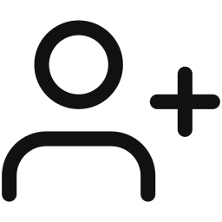

04 · AGENTIC WORKFLOW
From job creation to hiring decision — the full agentic lifecycle
Job Creation
Application step
Create Job
Upload JD
JD Agent
AI agent
Recruiter action
Raw JD text
Structured requirements,
weights, categories
Human / system gate
Add Candidate
Create Candidate
Upload Resume
Resume Agent
Evidence Retrieval
Against the job
PII extracted locally
& redacted
Privacy-filtered
skills profile
pgvector RAG,
historical cases
Gap Analysis
Question Agent
Coverage score +
cited gap reasoning
Screening, technical,
gap-validation Qs
All agent-bound content passes through central PII sanitisation before this boundary; shared agent memory writes calibration notes back after every human override.
04

Slide 5




04 · AGENTIC WORKFLOW
From job creation to hiring decision — the full agentic lifecycle
Interview
Interview
Transcript Captured
Transcript Eval.
Red Flag Agent
Quote-cited scoring
(reflexion)
Resume vs. interview
inconsistencies
Final Decision
Human Review
Decision packet:
advance / hold / reject
All agent-bound content passes through central PII sanitisation before this boundary; shared agent memory writes calibration notes back after every human override.
04

Slide 6
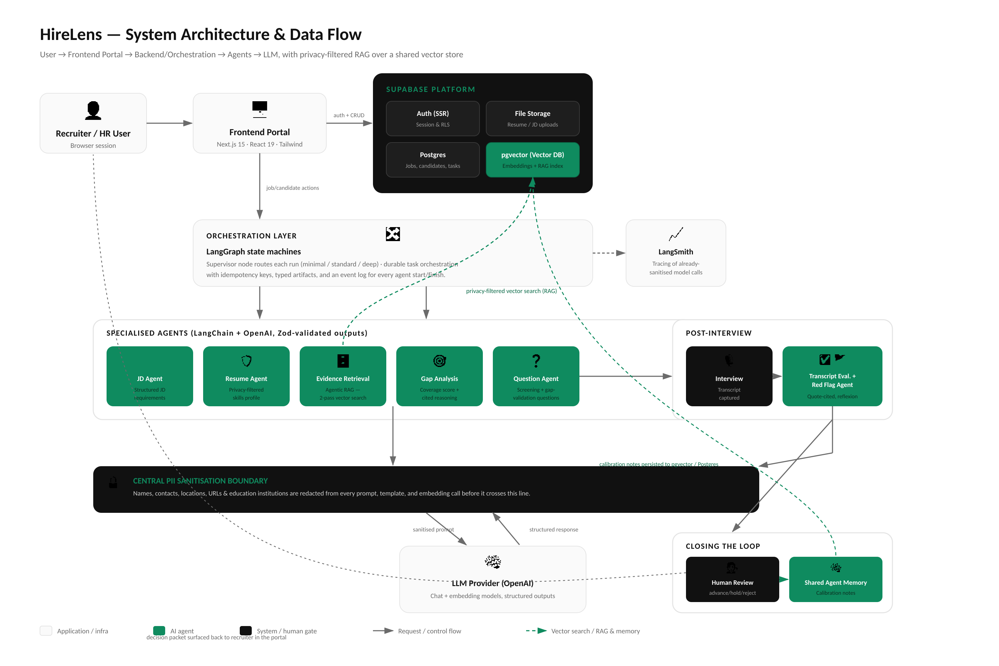

Slide 7
06 · TECHNICAL STACK
Reasoning, orchestration, and inputs across the pipeline
1
Reasoning layer
Chain-of-thought gap analysis, cited to evidence
TECH STACK
Frontend
Next.js 15, React 19, TypeScript 5, Tailwind 4, shadcn/ui
2
Orchestration
LangGraph state machines with supervisor routing
Backend & data
Supabase (Postgres + pgvector), RLS, Zod validation
3
Reflexion
AI / orchestration
LangChain + LangGraph, OpenAI chat & embeddings, LangSmith tracing
Failed validation → retry with feedback, once
Reliability
Reflexion retries, durable task orchestration, idempotency keys
4
Evaluation input
Text: resumes, JDs, interview transcripts
Parsing & tooling
unpdf, mammoth, pgvector RAG, Vitest / ESLint
HireLens today runs a text-evidence pipeline — resumes, JDs, and interview transcripts. Multi-modal signals (audio, video) are a scoped extension, not part of the current evidence chain, kept out deliberately to avoid unvalidated claims about candidates.
05

Slide 8
07 · VALIDATION & EDGE CASES
Production testing is built around edge cases, not happy paths
Proxy-interview / seniority mismatch
Advisory only
Red Flag Agent cross-checks interview depth against resume-stated seniority. An answer with expert-level architecture reasoning against a self-described fresher resume is flagged YELLOW/RED with the specific contradiction cited — never auto-rejected.
Unverifiable evaluation claims
Reflexion retry
Every transcript judgment must cite a direct quote. If a quote can’t be located in the transcript, output validation fails and the Reflexion loop retries the agent with explicit feedback on what was missing.
Reviewer override → systemic drift
Shared memory
When a human reviewer overrides an agent recommendation, a calibration note is written to shared agent memory. Repeated overrides of the same kind are written as bias warnings, read by agents before their next run.
Human-in-the-loop closes every loop: agent output is a decision packet with evidence and confidence, never a decision. The reviewer’s verdict is what gets written back into memory.
06

Slide 9
08 · ROI & BUSINESS OUTCOMES
The value case: faster hires, lower cost-per-hire, a reusable asset
↓ Time-to-hire
↓ Cost per hire
↑ Consistency
Removing manual resume-JD comparison and re-screen loops directly removes the 20–30 day rework tail identified in the problem statement.
Fewer agency escalations and fewer panel re-interviews as mismatches are caught before the interview stage, not after.
Every candidate is scored against the same structured requirement profile and the same historical evidence base, closing the recruiter-to-recruiter variance gap.
ILLUSTRATIVE ROI MODEL — SUBSTITUTE ACTUAL HIRING VOLUMES & RATES
Recruiter time saved
4–6 hrs/req manual screening × requisition volume × fully-loaded hourly rate
Cycle-time value
Days removed from time-to-hire × cost of an open seat (lost productivity / backfill premium)
Mis-hire avoidance
Fewer post-interview rejections × average cost of a failed interview/offer cycle
Beyond a 6–12 month payback, the durable value is structural: an institutional evidence base (pgvector) and a calibration store that compound with every hire — a reusable, scalable enterprise intelligence layer that outlasts any single recruiter.
07

